Slide 1
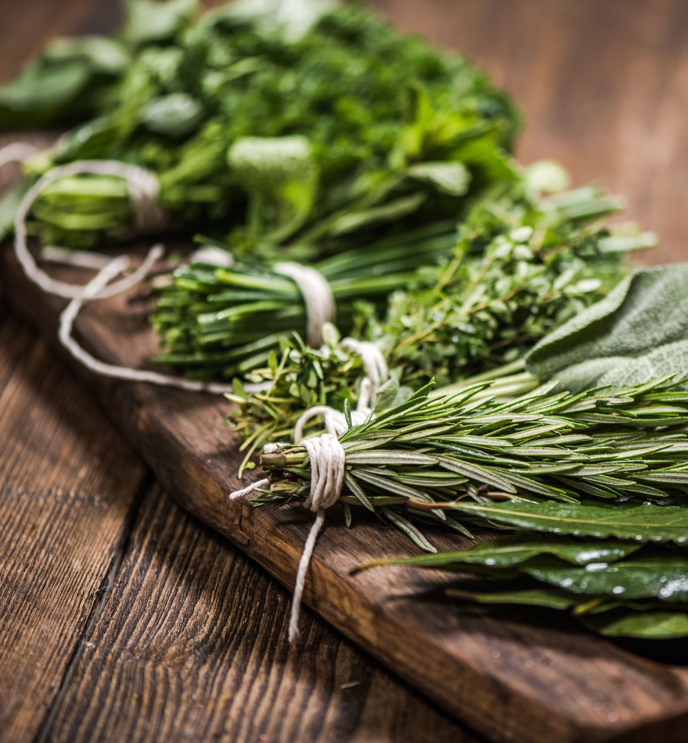
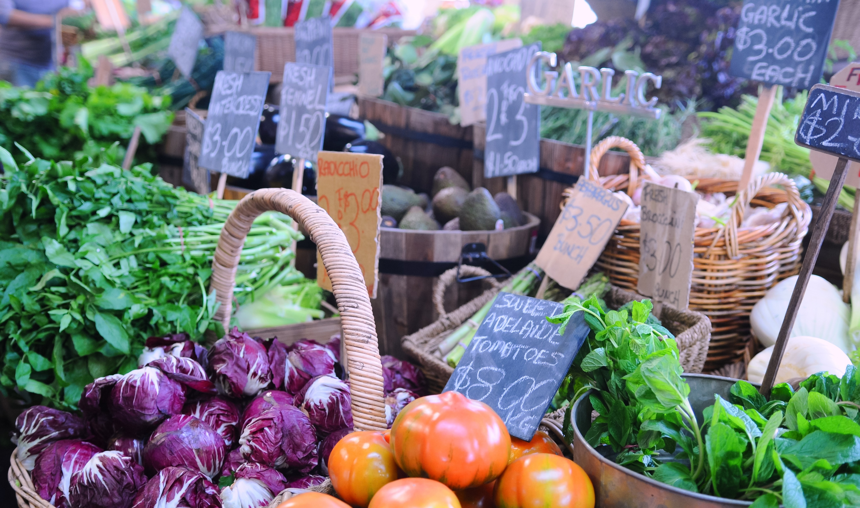
NUTRITION WORKSHOP

Slide 2
WHY IS NUTRITION IMPORTANT?
MAINTAIN AND/OR IMPROVE OUR HEALTH THROUGH ALL STAGES OF LIFE
REDUCE RISK OF DISEASE (Heart Disease, Type 2 Diabetes & some Cancers)
FEEL GOOD, FEEL ENERGIZED…FEEL LESS SLEEPY AFTER A MEAL!
NICER SKIN, HAIR,…NICER YOU
MAXIMISE PERFORMANCE & IMPROVE MOOD AT HOME, AT WORK, DURING CHOSEN PHYSICAL ACTIVITIES
& SOCIAL INTERACTIONS
TEACH LOVED ONES BY EXAMPLE AND BY SHARING THE PLEASURE OF GREAT FOOD
INVEST IN YOUR FUTURE TO LIVE YOUR BEST LIFE
“THE WHITER THE BREAD, THE SOONER YOU’LL BE DEAD” (anonymous grandmother)
&
“DON’T EAT ANYTHING YOUR GREAT GRANDMOTHER WOULDN’T RECOGNISE AS FOOD” (same anonymous grandmother)

Slide 3
WHAT CAN WE DO?
EDUCATE OURSELVES USING RELIABLE SOURCES
CONSIDER THE FOLLOWING: AGE, BUDGET, LIFESTYLE & ACTIVITIES,
HEALTH CONDITIONS
DETERMINE OUR HEALTHY WEIGHT
LISTEN TO YOUR BODY’S SIGNALS
SEEK EXPERT HELP WHEN NEEDED
GET ORGANISED FOR SUCCESS
“All we need to do is seek diet advice from dietitians, not unqualified wellness gurus, and not people with nice teeth, very tight abdomens and six packs”. Dr Karl

Slide 4
HOW TO SUCCEED?
AT HOME, FOLLOW YOUR PLAN
WHEN EATING AT FRIENDS/FAMILY’S HOME, OFFER TO BRING A DISH
WHEN EATING OUT, HAVE A LOOK AT THE MENU IN ADVANCE
EAT BEFORE YOU GET TOO HUNGRY
EAT BASED ON YOUR LONG-TERM VISON
& NOT BASED ON YOUR SHORT-TERM VISION
REMEMBER TO BUY/EAT FOOD … NOT NOT-FOOD!!!
“DON’T GET YOUR FUEL FROM THE SAME PLACE YOUR CAR DOES”
&
“AVOID THE EDIBLE FOOD LIKE SUBSTANCES” (Michael Pollan)

Slide 5
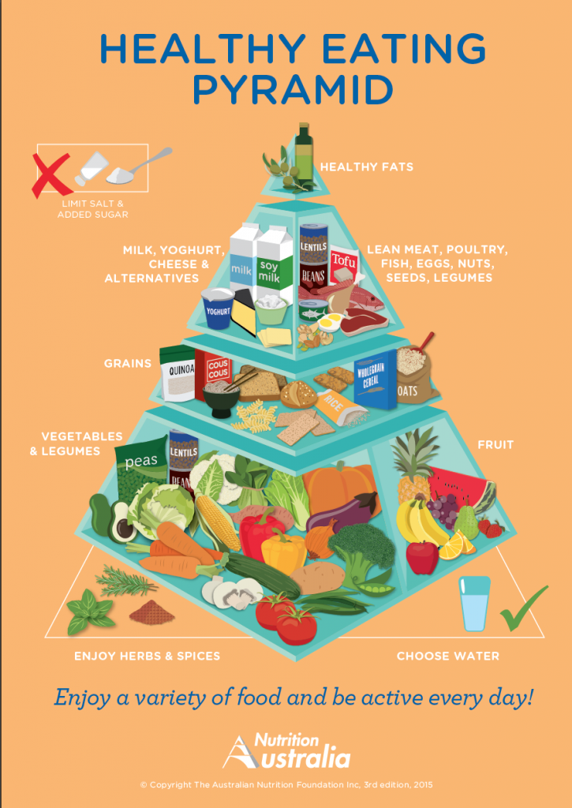
NUTRITION AUSTRALIA CHECK OUT WEBSITE FOR GREAT TIPS & RECIPES
Top Layer-Healthy Fats: Extra virgin olive oil,
Nut & Seed oils
Middle Layer: Dairy & Non-Dairy alternatives
+ Lean Meat, Poultry, Fish, Eggs, Nuts, Seeds, Legumes
Bottom Layer : 70% of what we eat
Vegetable & Legumes- 5 serves each day
Fruits-2 serves each day
Grains-mostly wholegrains (brown rice, oats, barley, quinoa, …)
*Limit Salt & added Sugar*Have fun with Herbs & Spices*

Slide 6
VEGETABLES 40% GRAINS 30% FRUITS 10% PROTEINS 20% DAIRY-SMALL AMOUNT

Slide 7
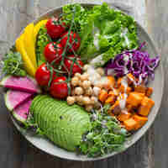
NUTRITION & MENTAL HEALTH
1. Protein
2. B vitamins
3. Healthy fats
4. Your gut
5. Sugar
6. Hormones
7. Weight
*Omega 3 Fatty acids
Put simply: some foods inflame the brain that is already
inflamed by stress.
Increase veggies & fiber; buy organic when you can; cut down
processed food; decrease meat, dairy, sugar &
gluten; white rice and bread (these are addictive), avoid
Genetically Modified (GM) Foods and read the labels.

Slide 8
PERSONAL HABITS-LET’S WORK IT OUT *IT’S WHAT WE DO 80% OF THE TIME THAT MAKES THE DIFFERENCE*
QUALITY
QUANTITY
SPACING
SEQUENCE
VARIETY
LIFESTYLE/STAGE
PURPOSE
ENVIRONMENT
BALANCE
REFLECTION

Slide 9
☺GUT HEALTH☺ Our gut microbiome is home to more than 100 trillion bacteria! On average 1200 different species of Bacteria in our gut… 1600 would be better!!!
PREBIOTICS
PROBIOTICS
***HARMFUL TO YOUR GUT***
-ANTIBIOTICS OVERUSE,
-PROCESSED WESTERN DIET,
-STERILIZED HOMES
“The Good Gut” written by Justin & Erica Sonnenburg
This Photo by Unknown Author is licensed under CC BY-NC

Slide 10
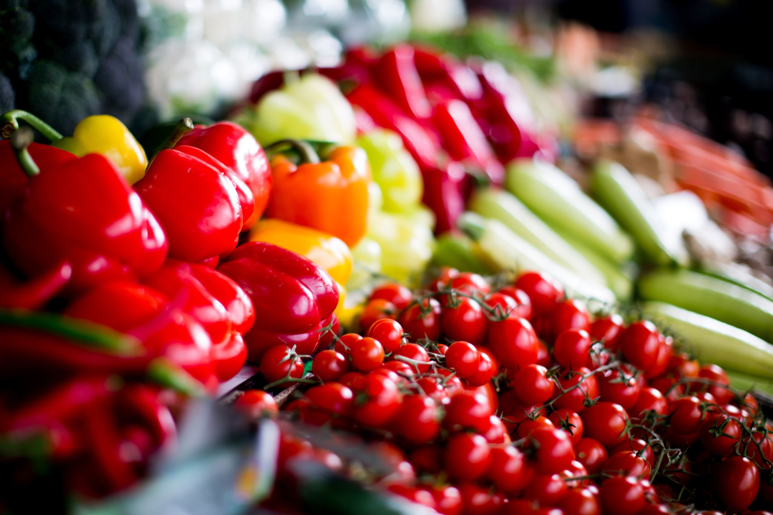
TIPS
EAT REAL FOOD
SHOP AROUND THE PERIPHERY OF THE SUPERMARKET AND YOU WILL FIND:
FRUITS, VEGETABLES, DAIRY PRODUCTS, MEAT, POULTRY, FISH & SEAFOOD AND WHOLE GRAINS
REGULARLY CLEAN UP YOUR REFRIGERATOR, FREEZER AND PANTRY;
THROW AWAY EXPIRED ITEMS & REFILL WITH FABULOUS REAL FOOD!
OUR FRIENDLY VEGETARIANS OR VEGANS NEED TO BE MINDFUL OF THEIR IRON & B-12 INTAKE
OCCASIONALLY, ENJOY A TREAT
FRESH FOOD IS BEST…YOU ARE WORTH IT ☺
“EAT FOOD, MOSTLY PLANTS, NOT TOO MUCH”
(In Defense of Food by Michael Pollan)
PLEASE SHARE ONE OF YOUR NUTRITION TIPS OR DISCOVERIES
& SHARE ONE OF YOUR FAVORITE RECIPES
BONNE APPETIT MES AMIS!

